Slide 1
games Programming 3
Lecture 1:
Cameras & Delta time
& Buffers

Slide 2
Cameras
Cameras do not actually exist!
The are conceptual
Matrix that hold the information of where we are going to render the scene from.
OpenGL by itself is not familiar with the concept of a camera, but we can try to simulate one by moving all objects in the scene in the reverse direction, giving the illusion that we are moving. “View Space”

Slide 3
Cameras
View space: Covered last year V * M matrices
View matrix transforms all the world coordinates into view coordinates that are relative to the camera's position and direction.
Create a coordinate system with 3 perpendicular unit axes with the camera's position as the origin. i.e. X,Y,Z vectors

Slide 4
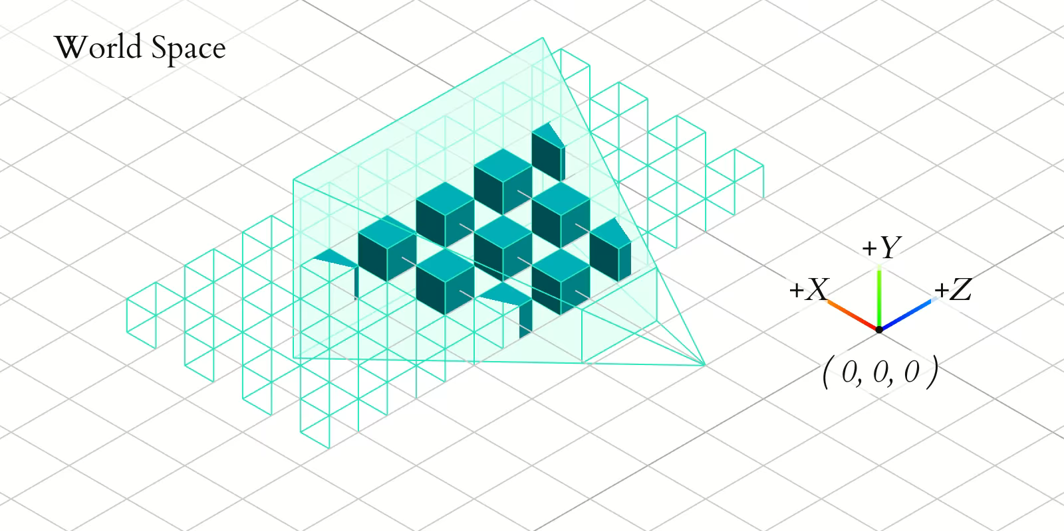
Cameras

Slide 5
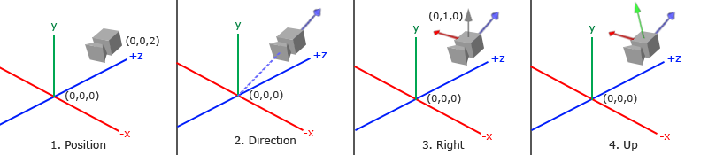
Cameras
We need to store three things
Position (Vec3)
Direction (Vec3)
UpVector (We can use this & Direction to calculate the other vectors: left, right, etc) – Vec3

Slide 6
Position
The camera position is a vector in world space that points to the camera's position
Stored in Camera.h
glm::vec3 pos;
Set when we initalise our camera
myCamera.initCamera(glm::vec3(0, 0, -5),..
Changed when we update position
myCamera.MoveUp(0.2f);

Slide 7
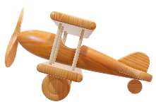
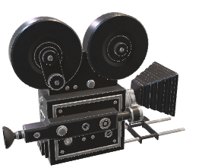
Direction
Camera's direction i.e. what is the camera looking at
If we subtract two vectors from each other we get a vector that's the difference of these two vectors. i.e.
P2
V = P2 – P1
P1
Normalised V = forward

Slide 8
Direction Z-Axis
For the view matrix's coordinate system we want its z-axis to be positive and because by convention (in OpenGL) the camera points towards the negative z-axis we want to negate the direction vector
I.e. if the camera is not looking in the direction it should be then trying changing your order +/-

Slide 9
Right X-Axis
The next vector that we need is a right vector that represents the positive x-axis of the camera space
To get the right vector we use a little trick by first specifying an up vector that points upwards (in world space)
void initCamera()
{
this->up = glm::vec3(0.0f, 1.0f, 0.0f);
}

Slide 10
Right X-Axis
Then we do a cross-product on the up vector and the direction vector
The result of a cross-product is a vector perpendicular to both vectors, we will get a vector that points in the positive x-axis's direction
Switch the cross-product order we'd get a vector that points in the negative x-axis
If you have right, then you also have left

Slide 11
LookAt Matrix
Using these camera vectors we can now create a ”LookAt” matrix that proves very useful for creating a camera
If you define a coordinate space using 3 perpendicular axes you can create a matrix with those 3 axes
You can transform to that coordinate space by multiplying by this matrix.

Slide 12
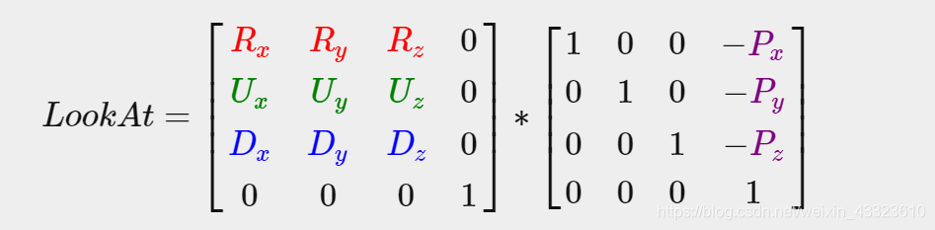
Look at Matrix
This is exactly what the LookAt matrix does and now that we have 3 perpendicular axes and a position vector to define the camera space we can create our own LookAt matrix:

Slide 13
LookAt Matrix
R is the right vector
U is the up vector
D is the direction
P is the camera position

Slide 14
LookAt Matrix
GLM creates this for us
glm::lookAt(pos, pos + forward, up);
This is our view matrix (MVP)
We can now use this to make many types of camera
Match model vectors, use offsets for position etc

Slide 15
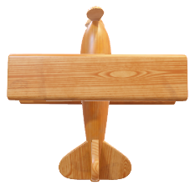
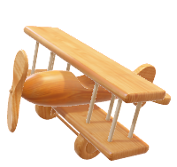
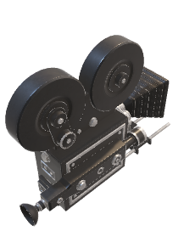
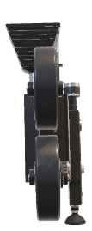
Example Chase Camera
Up Vector
Forward Vector
Position
Reverse the forward vector and scale it to create an offset value, and make that the cameras position

Slide 16
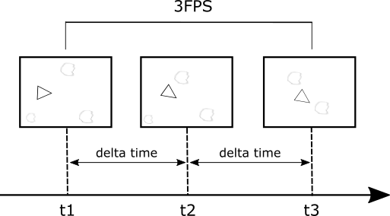
Delta Time
Delta time, or also referred to as elapsed time.
Delta time describes the time difference between the previous frame that was drawn and the current frame.

Slide 17
Delta Time
Delta time, or also referred to as elapsed time.
Delta time describes the time difference between the previous frame that was drawn and the current frame.

